Slide 1

Breast Cancer Classification
-Machine Learning Projects
-Logistic Regression

Slide 2
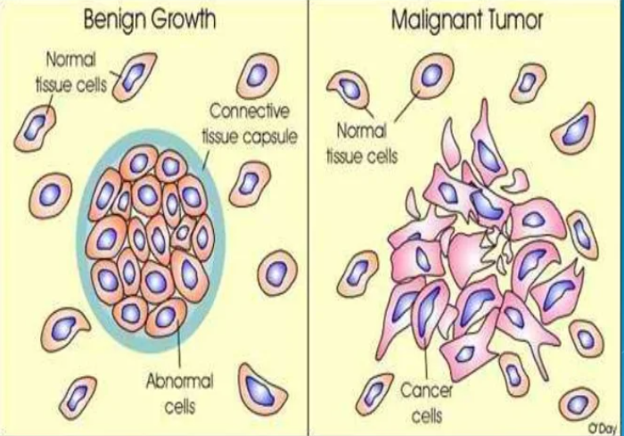
Types of Tumor

Slide 3
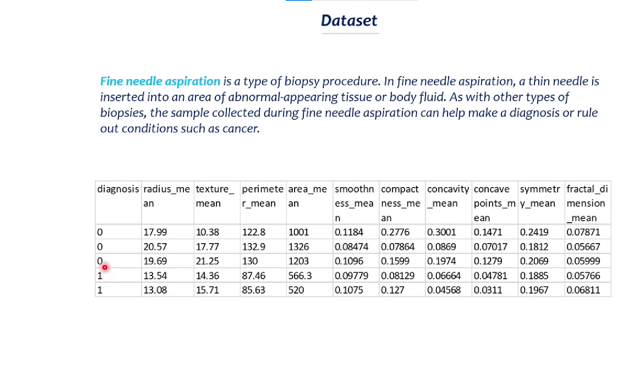

Slide 4
